Slide 1


EXPLORING THE FUTURE: AUGMENTED REALITY AND VIRTUAL REALITY DISPLAYS
By:
Miss.Vaishnavi Saindane
Roll no: 74
Department of Computer Science and Engineering(Data Science)
Vidyavardhini’s College of Engineering and Technology

Slide 2
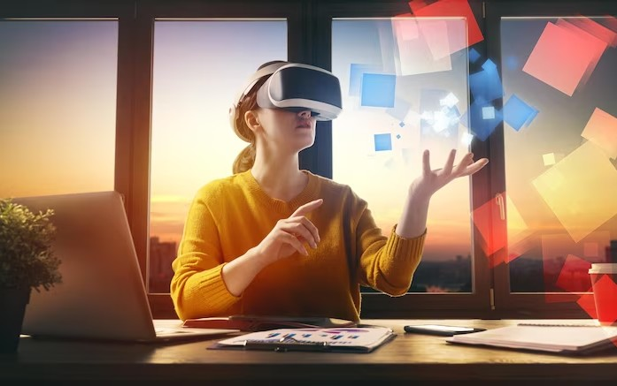
Introduction
Augmented Reality (AR) and Virtual Reality (VR) are transforming the way we interact wit h digit al content.
AR overlays digital information onto the real world, enhancing our perception.
VR immerses users in a simulated environment. Both technologies have immense potential in ﬁelds like gaming, education, and healthcare.
This exploration delves into the various aspects of AR and VR displays, encompassing the latest developments, key players in the industry, the evolution of hardware, and the applications that are reshaping industries and everyday life.

Slide 3

AR VS VR
While AR enhances the real world, VR creates a completely virtual environment.
AR allows users to interact with the real world while overlaying digital information, whereas VR offers immersive experiences with no connection to the real world.
Both technologies have unique applications and are advancing rapidly, but they differ in terms of user experience and level of immersion.

Slide 4
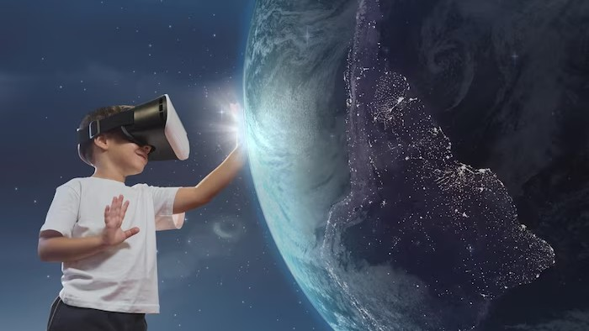
APPLICATIONS OF AR
Enhanced Navigation
Training and Education
Augmented Retail Healthcare.
Gaming

Slide 5
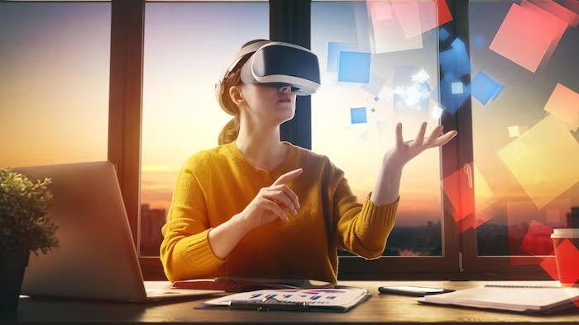
APPLICATIONS OF VR
Gaming
Training and Simulation
Therapy and Rehabilitation
Architectural Visualization
Entertainment and Storytelling

Slide 6
Challenges and Future Developments
Challenges | Future Developments
Hardware Limitations | Improved Hardware
Content Quality | 5G Integration
Motion Sickness | Content Expansion
Privacy and Security | Healthcare Advancements

Slide 7
CONCLUSION
Augmented Reality and Virtual Reality displays are transforming various industries and opening up new possibilities.
AR enhances our perception of the real world, while VR immerses us in virtual environments.
Both technologies have unique applications and challenges.
As the hardware improves and research progresses, we can expect even more exciting developments in the future.
Embracing AR and VR will undoubtedly shape the way we interact with digital content.

Slide 8
Thank You !

